Slide 1
Virtual Assistant Using NLP
Created by,
G.KRISHNAVENI
Reg.No:912321104016
NM id: au912321104016
CSE 3rd year,
SACS MAVMM ENGINEERING COLLEGE,
MADURAI.

Slide 2
Project outline:
Problem statement
Proposed system/solution
System development approach
Algorithm and deployment
Result
References
conclusion

Slide 3
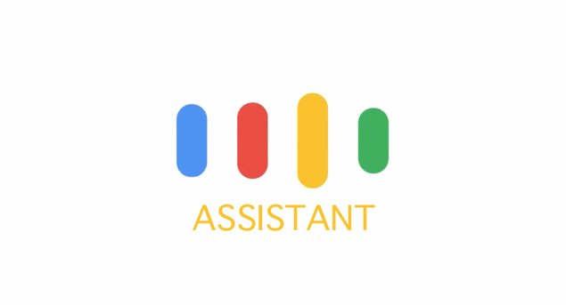
Problem Statement:
Design and implement a Python-based virtual assistant capable of understanding and executing user commands. The virtual assistant should utilize NLP algorithms for speech recognition, intent recognition, and language generation. It should be able to perform tasks such as web searches, answering queries, setting reminders, and providing personalized assistance.

Slide 4
Proposed system/solution:
The proposed system aims to develop a Python-based virtual assistant leveraging Natural Language Processing (NLP) techniques for understanding and executing user commands.
1.Speech Recognition:
Implementing speech-to-text functionality to convert user voice commands into text.
2.Intent Recognition:
Utilizing NLP algorithms to understand user intents and extract relevant information from the input text.

Slide 5
Proposed system/solution: CONTD...
3.Task Execution: ​
Executing tasks based on recognized intents, such as web searches, information retrieval, setting reminders, etc.
4.Text-to-Speech Conversion:
Converting the assistant's responses into natural-sounding speech for user interaction.

Slide 6
Proposed system/solution: CONTD...
5.Error Handling:
Implementing robust error handling mechanisms to handle unexpected inputs and ensure smooth operation.
6.User Interface:
Designing a user-friendly interface for interaction with the virtual assistant, displaying text outputs, and receiving user commands.

Slide 7
System Development Approach:
Hardware Requirements:
Processor:
A processor with a high clock speed and multiple cores for efficient processing of NLP tasks.
Memory (RAM):
Minimum 4 GB of RAM to handle data processing and algorithm execution effectively.
Microphone:
A good quality microphone for capturing voice commands and input.

Slide 8
Software Requirements:
Operating System:
Windows 10 or higher is recommended for compatibility with various Python libraries and tools.
Python:
Python programming language installed on the system, preferably the latest version, to develop the virtual assistant.
Python Libraries:
Installation of Python libraries such as NLTK (Natural Language Toolkit), spaCy, speech recognition, and other NLP-related libraries for implementing NLP functionalities

Slide 9
Algorithm and deployment:
Speech Recognition:
Use libraries like Speech Recognition to convert speech input into text.
Natural Language Understanding (NLU):
Implement NLU algorithms to understand user intents and extract relevant information from text inputs.
Response Generation:
Develop algorithms to generate appropriate responses based on user queries using predefined templates or machine learning models.

Slide 10
Algorithm and deployment: CONTD...
Dialog Management: ​
Implement a dialog management system to maintain context and manage the conversation flow.​
Integration with External Services: ​
Integrate with APIs or services for tasks like fetching information from the web, sending emails, or performing other actions.​

Slide 11
Dataset:
Embrace the power of data-driven insights and embark on a journey of discovery with [Virtual Assistant], fostering informed decision-making and transformative discoveries. Access the data set at [Training Dataset for chatbots/Virtual Assistants (kaggle.com)] and unlock its full potential today.

Slide 12
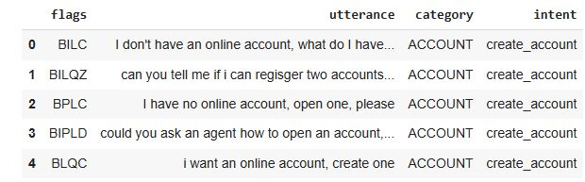
Result:
Fig.1 : Output

Slide 13
Reference:
Training Dataset for chatbots/Virtual Assistants (kaggle.com)]
AssistentePessoal/assistente.py at main · rafaballerini/AssistentePessoal · GitHub
https://data-flair.training/blogs/voice-assistant-project-python/

Slide 14
Conclusion:
Virtual assistants powered by Natural Language Processing (NLP) revolutionize human-computer interactions. NLP enables conversational interactions, task execution, and even simulates empathy. Ultimately, it enhances user experiences by bridging the gap between humans and machines.

Slide 15
Thank you

